Slide 1
Network Services
Networking for Home and Small Businesses – Chapter 6

Slide 2
Objectives
Compare and contrast clients and servers and their interaction over the network.
Describe the type of interactions of Internet applications.
Describe the purpose of a layered model
Illustrate the interaction of various protocols.

Slide 3
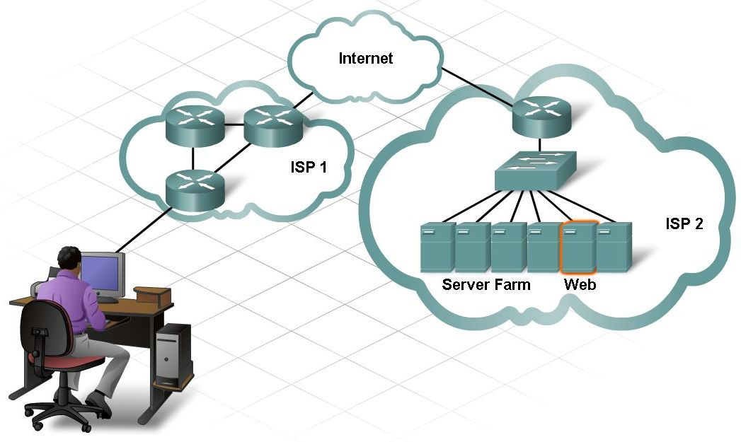
Compare and Contrast Clients and Servers
Review the client/server relationship.

Slide 4
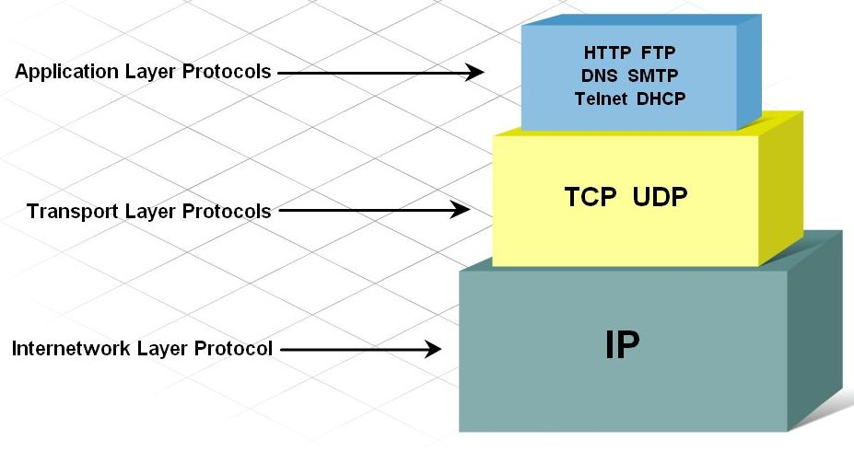
Client-Server Protocols
Application, Transport, Internetwork and Network access protocols.

Slide 5
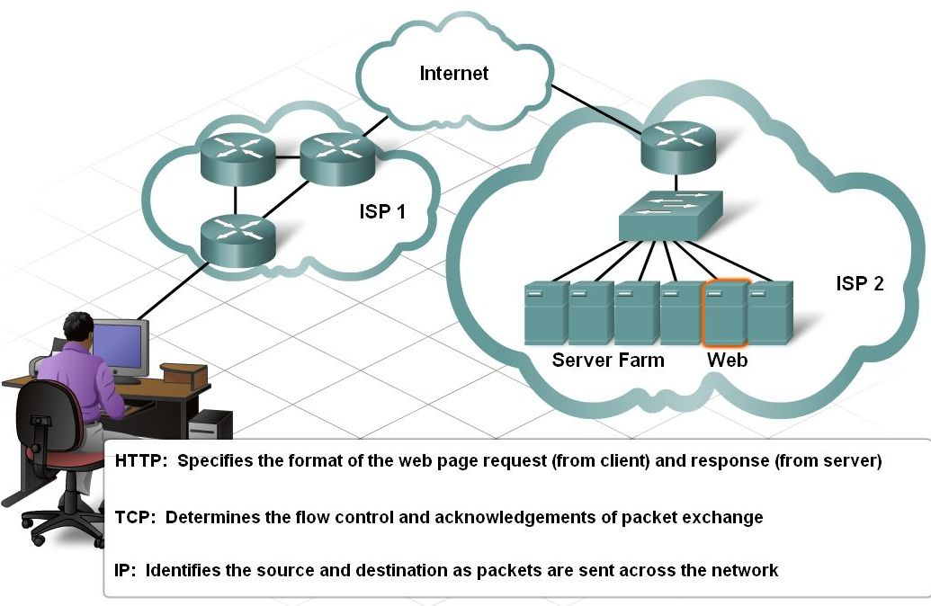
TCP and UDP Transport Protocols
Differentiate between acknowledged versus unacknowledged protocols.

Slide 6
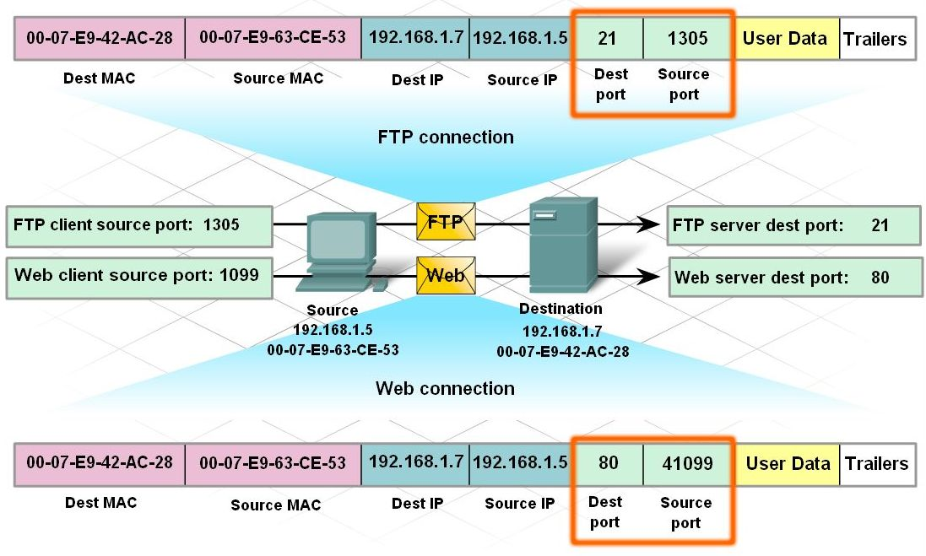
Port Numbers in Client-Server Conversations
Describe the function of a port.

Slide 7
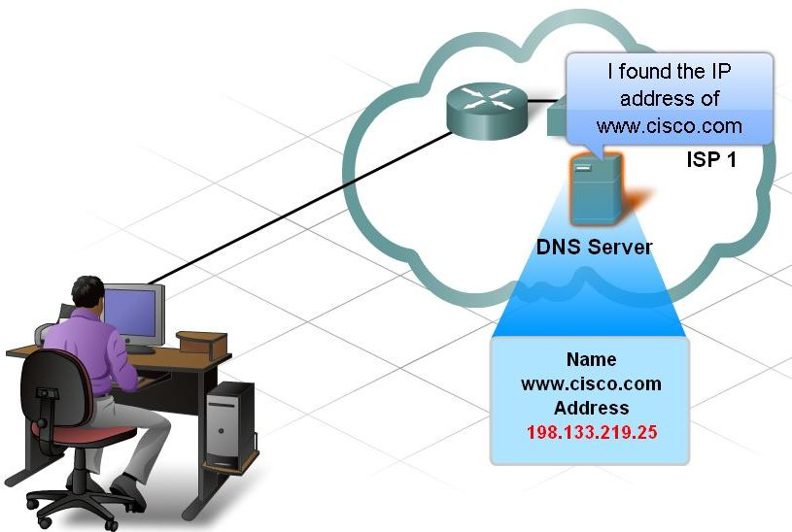
Types of Interactions of Internet Applications
Describe DNS and its purpose.

Slide 8
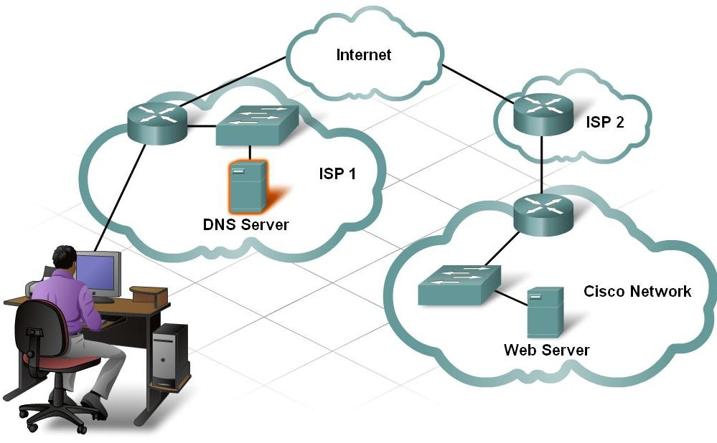
Types of Interactions of Internet Applications
Describe the interaction between a web client and a web server.

Slide 9
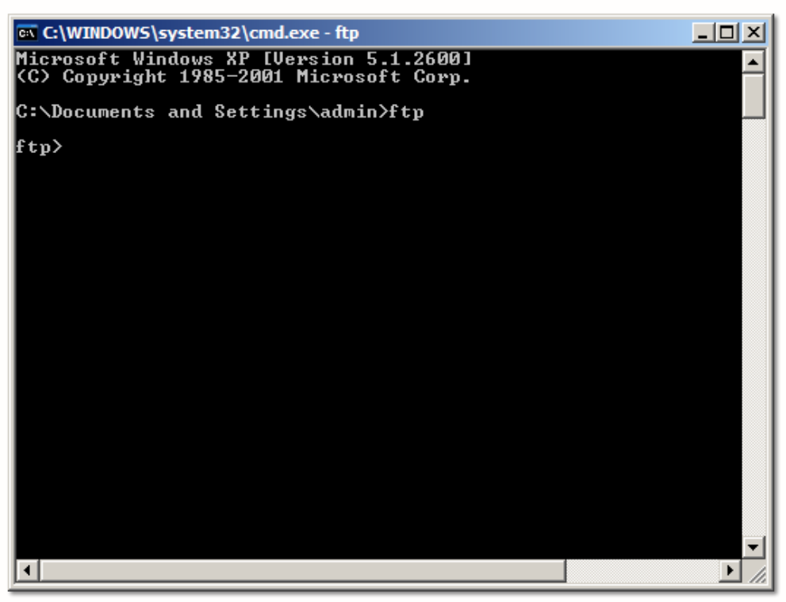
Types of Interactions of Internet Applications
Describe the interaction between an FTP client and an FTP server.

Slide 10
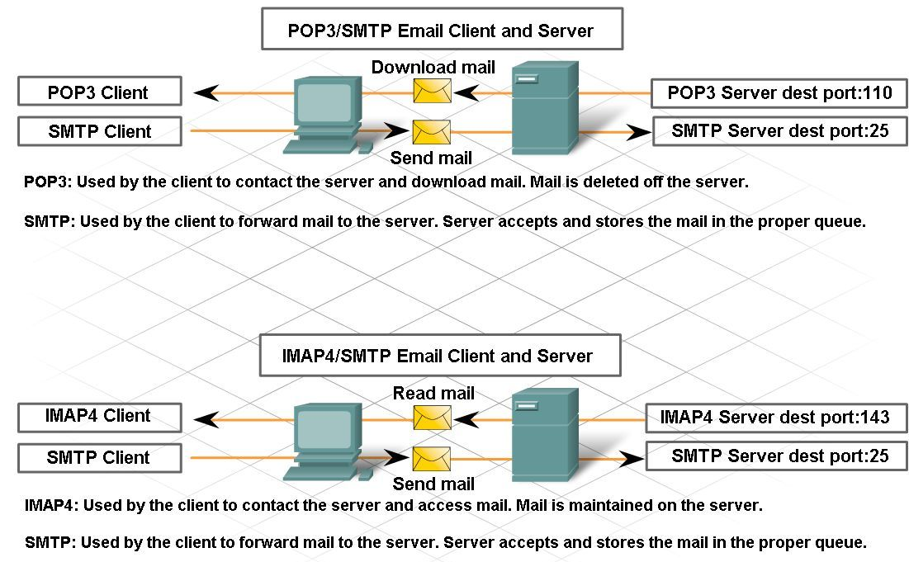
Types of Interactions of Internet Applications
Describe the interaction between e-mail clients and e-mail servers.

Slide 11
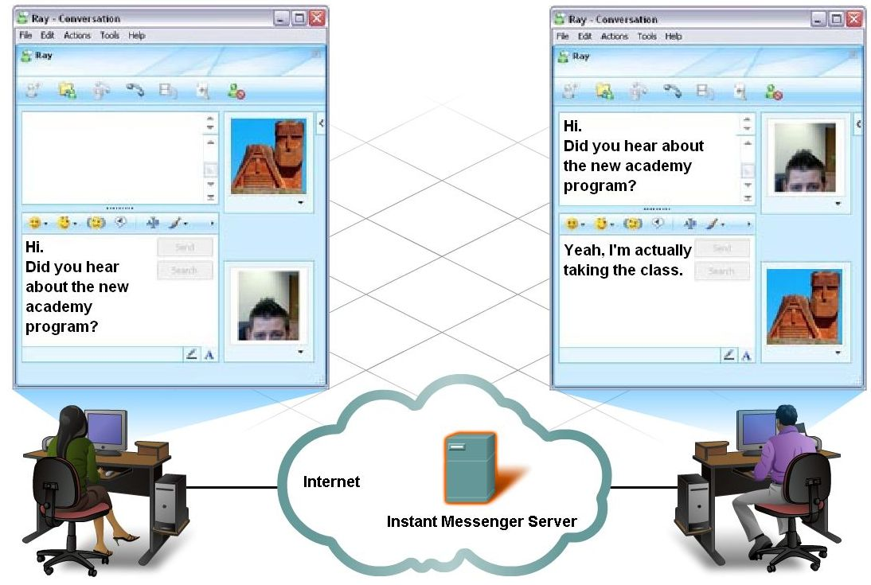
Types of Interactions of Internet Applications
Describe the interaction between IM / Peer-to-Peer clients and e-mail servers.

Slide 12
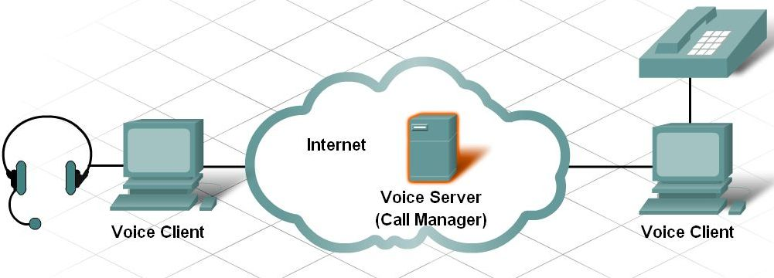
Types of Interactions of Internet Applications
Describe the interaction between voice clients and servers.

Slide 13
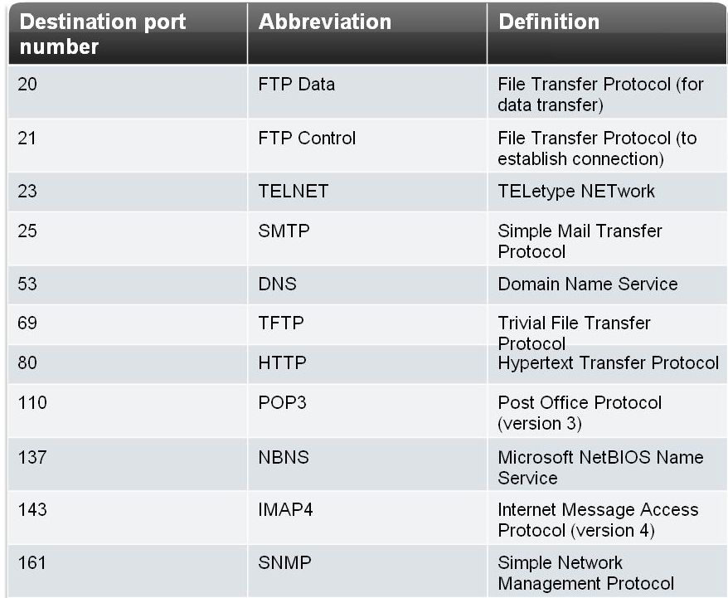
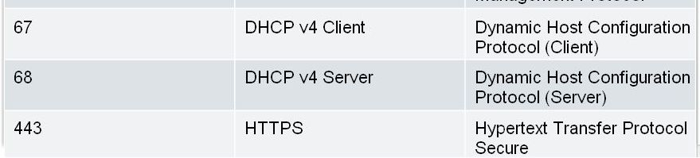
Types of Interactions of Internet Applications
Well-known ports
Registered ports
Private ports

Slide 14
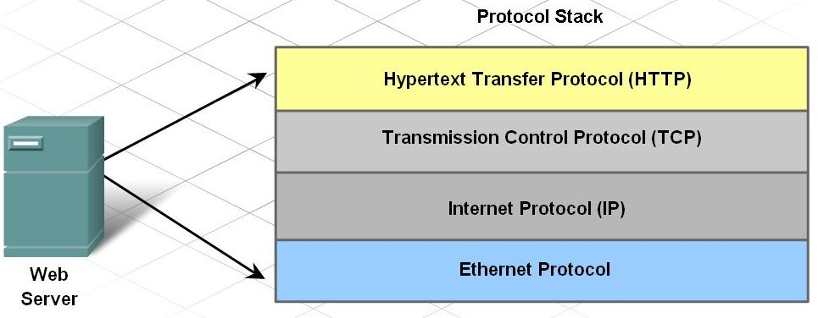
Purpose of a Layered Model
Protocols operate as an interdependent stack
Each layer provides and receives services

Slide 15
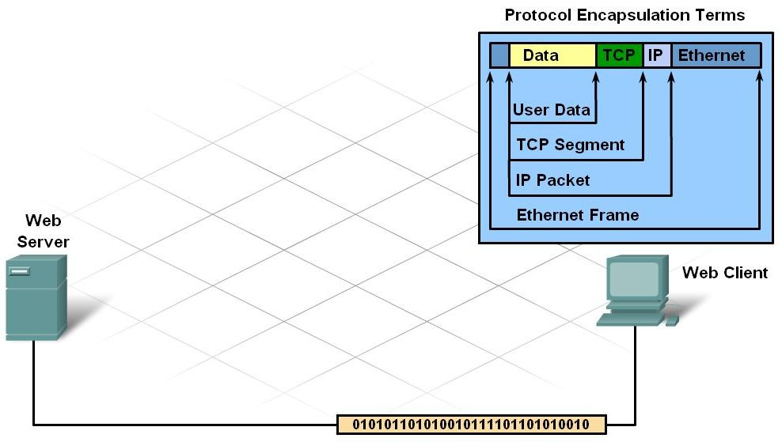
Purpose of a Layered Model
Describe protocol operation when sending and receiving a message.

Slide 16
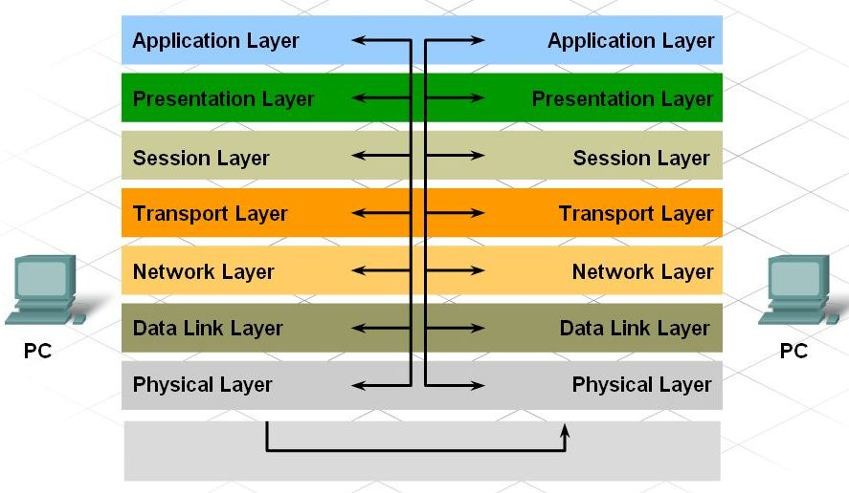
Purpose of a Layered Model
Describe the Open Systems Interconnect Model

Slide 17
Summary
Clients and servers use protocols and standards for exchanging information.
Client-server services are identified through the use of port numbers.
A protocol stack organizes the protocols in layers, with each layer providing and receiving services from the layers below and above it.
When sending messages, protocols interact from the top layer to the bottom of the stack.
When receiving messages, protocols interact from the bottom layer to the top of the stack.

